Slide 1


Slide 2
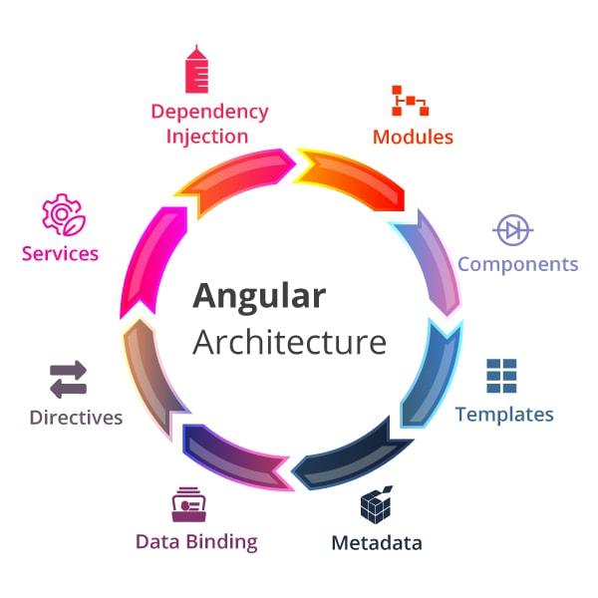
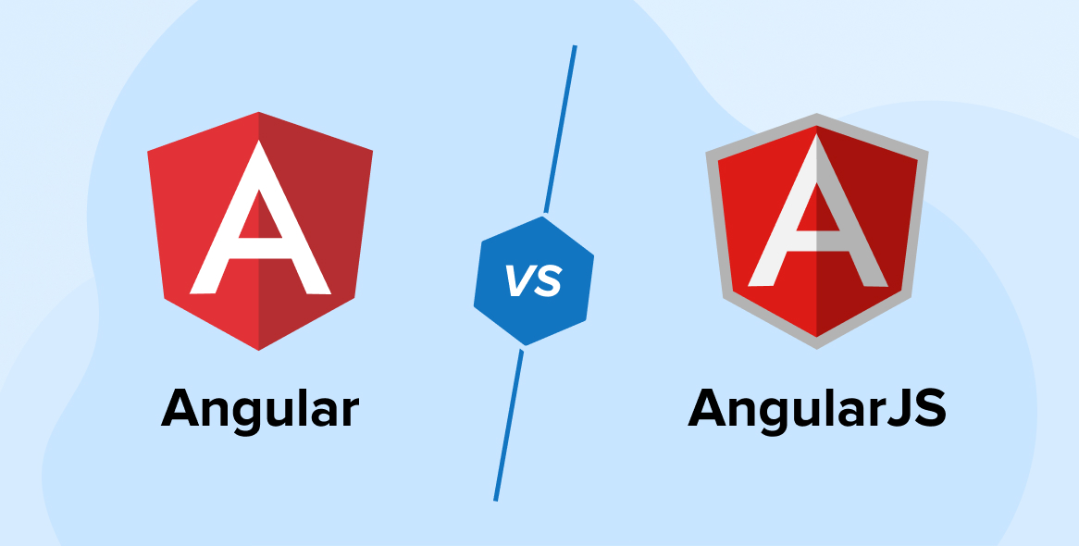
What’s Angular?
Angular is a web framework developed by Google to help developers build modern web applications easily and efficiently.

Slide 3
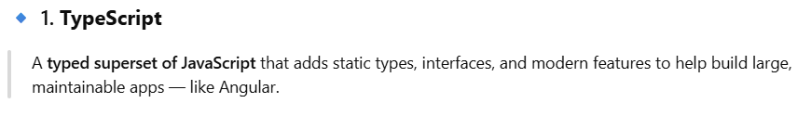
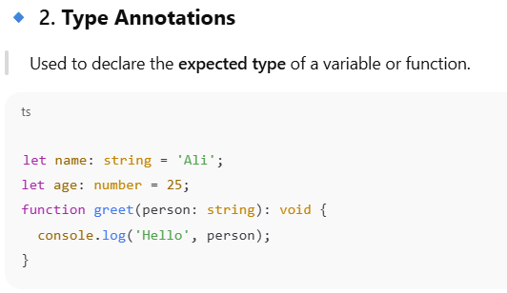
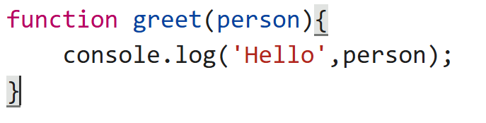
Typescript ( For Angular )

Slide 4
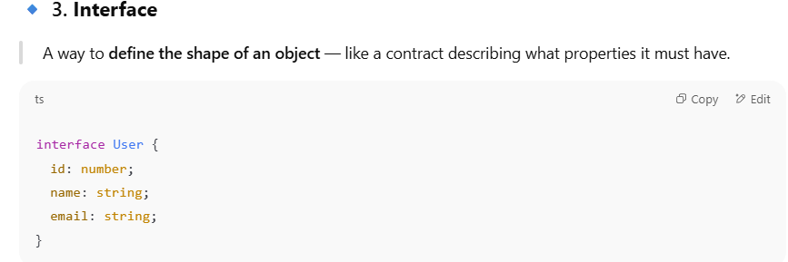
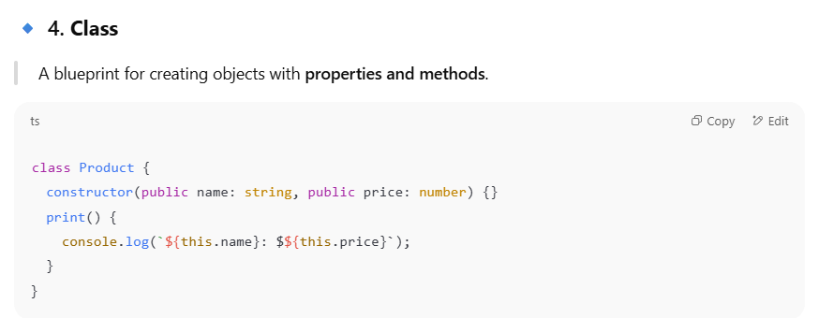
https://transform.tools/typescript-to-javascript

Slide 5
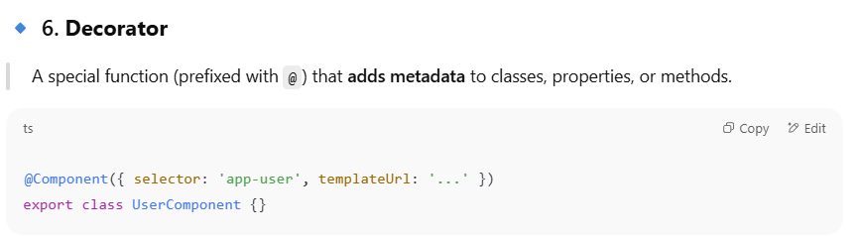
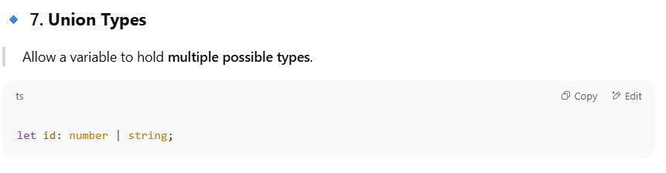
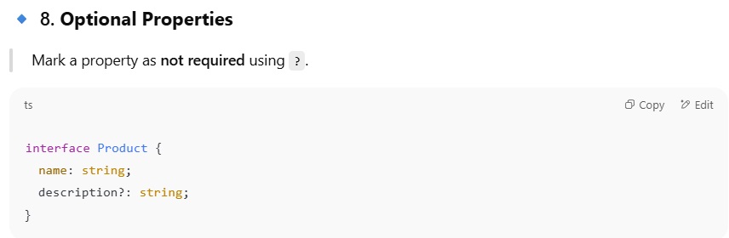

Slide 6
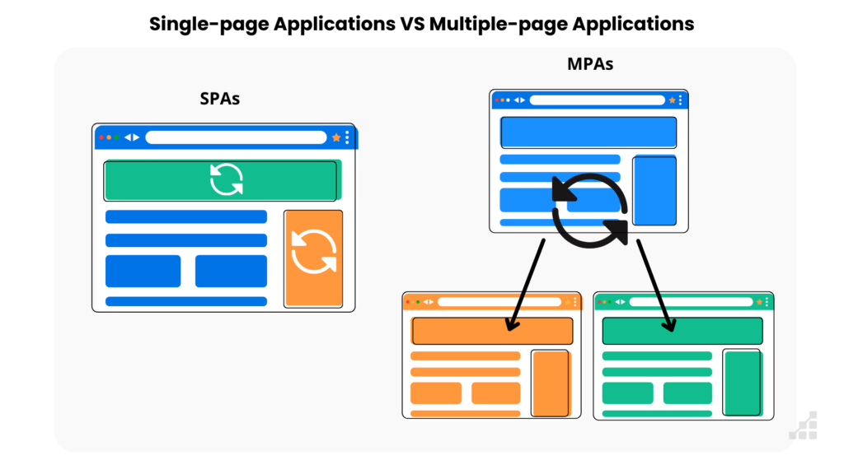
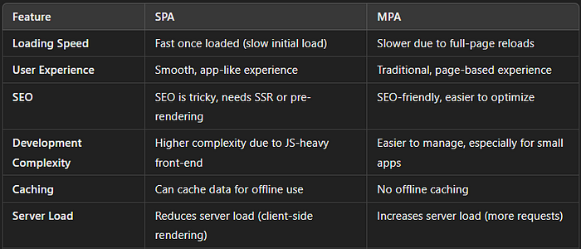
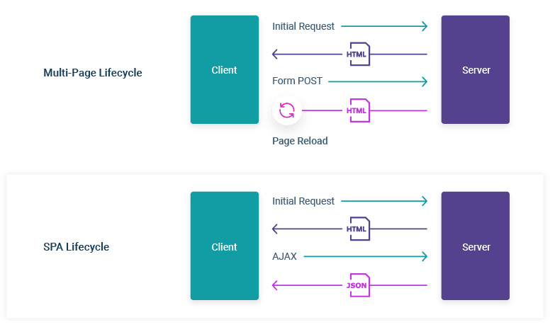
SPA VS MPA
For More

Slide 7
SPA VS MPA
One and Only HTML page for the entire application,
Dynamically update the single page with new data if needed, as the user interacts with the app,
Show and Hide some components during the interaction process,
No reloading or refreshing during navigation, More responsive & fluid app as a result,
Full separation between the presentation logic & business logic,
Asynchronous Requests (AJAX), JSON response & RESTful API.

Slide 8
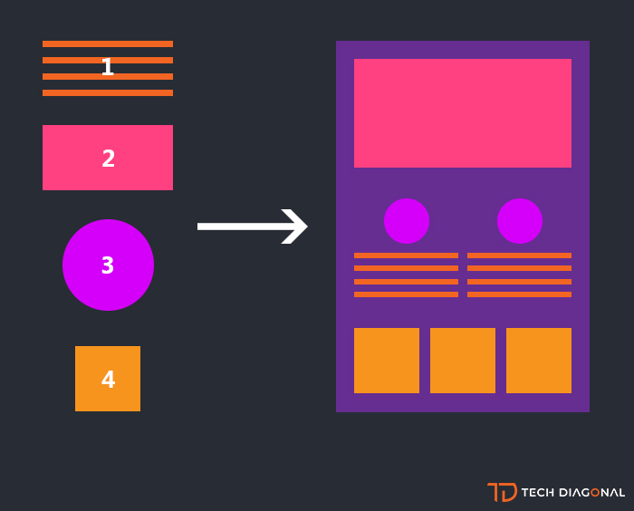
Component ??
A component in is the building block of the user interface. Every screen or part of the screen you see in an app (like a header, form, button, or page) is usually a component.
Any component consists of:
an HTML template (what you see)
CSS styles (how it looks)
JS Code contain logic (how it behaves)

Slide 10
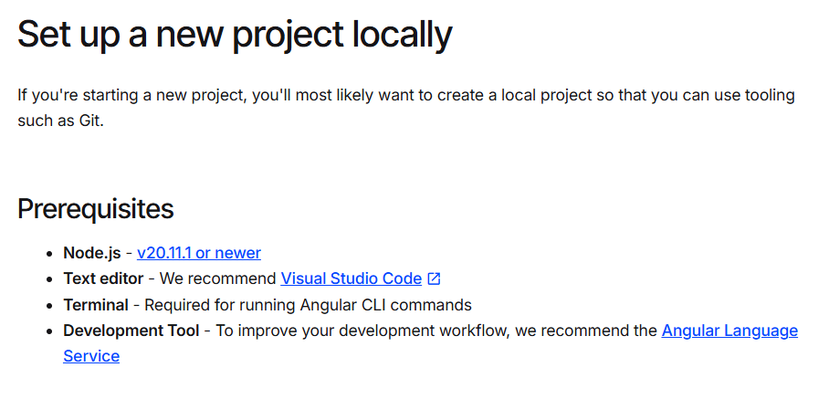
ng --version
https://angular.dev/installation

Slide 11
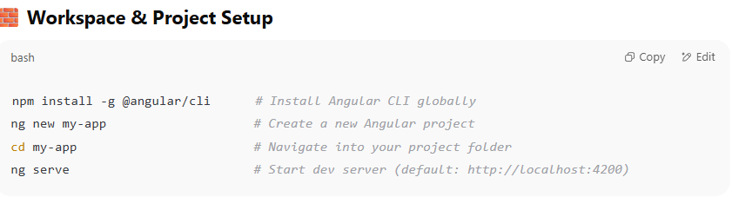
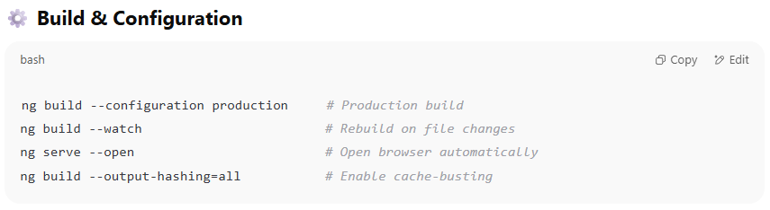
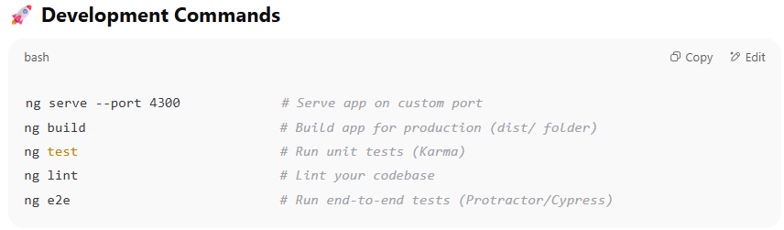
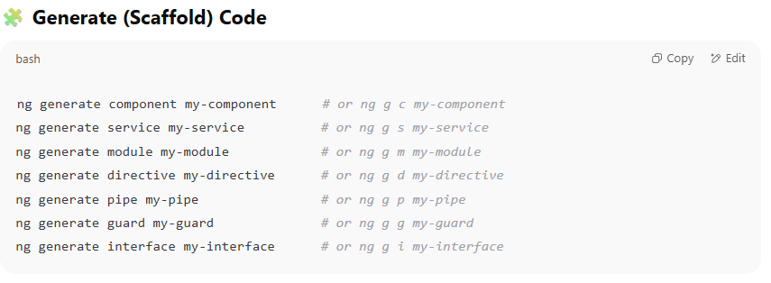
Angular CLI ( Command Line Interface )

Slide 12
New Angular Project
https://angular.dev/installation#create-a-new-project
Angular Project File Structure

Slide 13
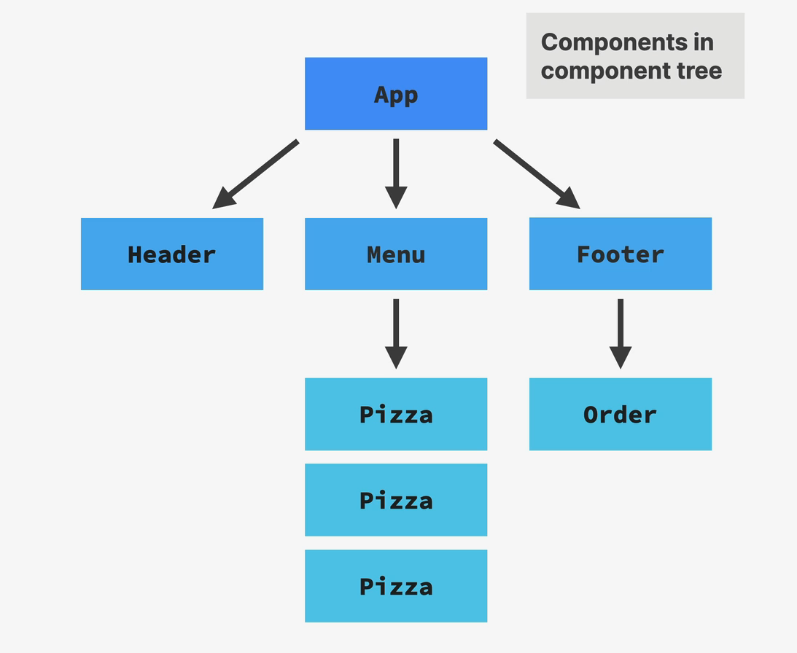
Component in angular
A component in Angular is the building block of the user interface. Every screen or part of the screen you see in an Angular app (like a header, form, button, or page) is usually a component.
Any component consists of:
an HTML template (what you see)
CSS styles (how it looks)
TS Code contain logic (how it behaves)

Slide 14
Data Binding

Slide 15
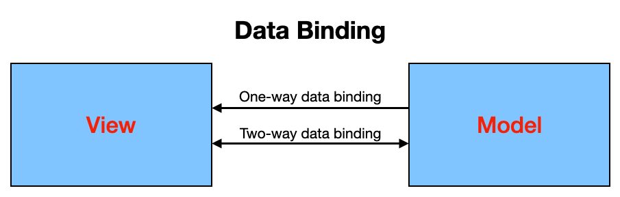
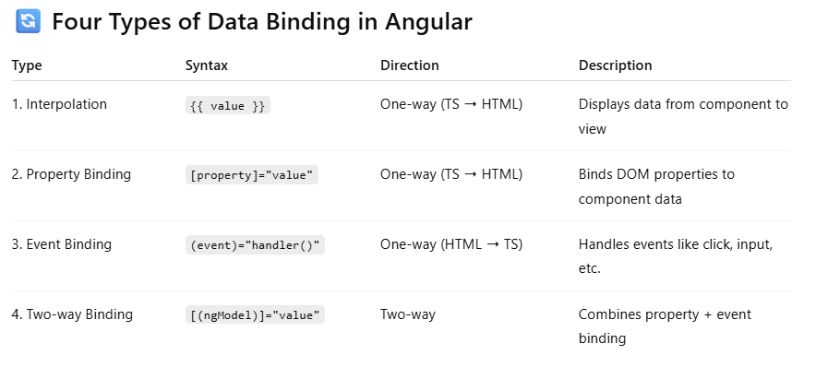
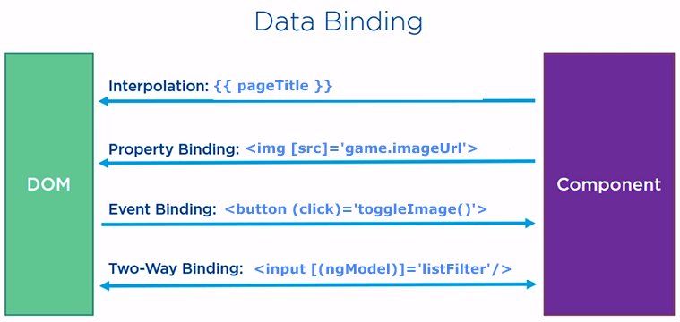
Data Binding
Data Binding in Angular is the connection between your HTML and your TypeScript (component) code.
It lets your app respond to user actions, display dynamic data, and keep the UI in sync with the logic.

Slide 16
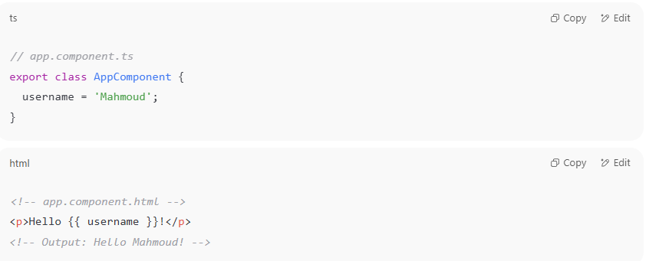
Data Binding
Interpolation

Slide 17
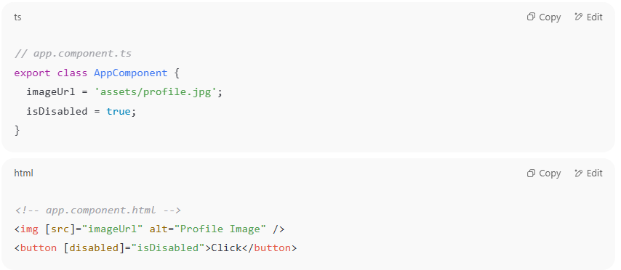
Data Binding
Property Binding

Slide 18
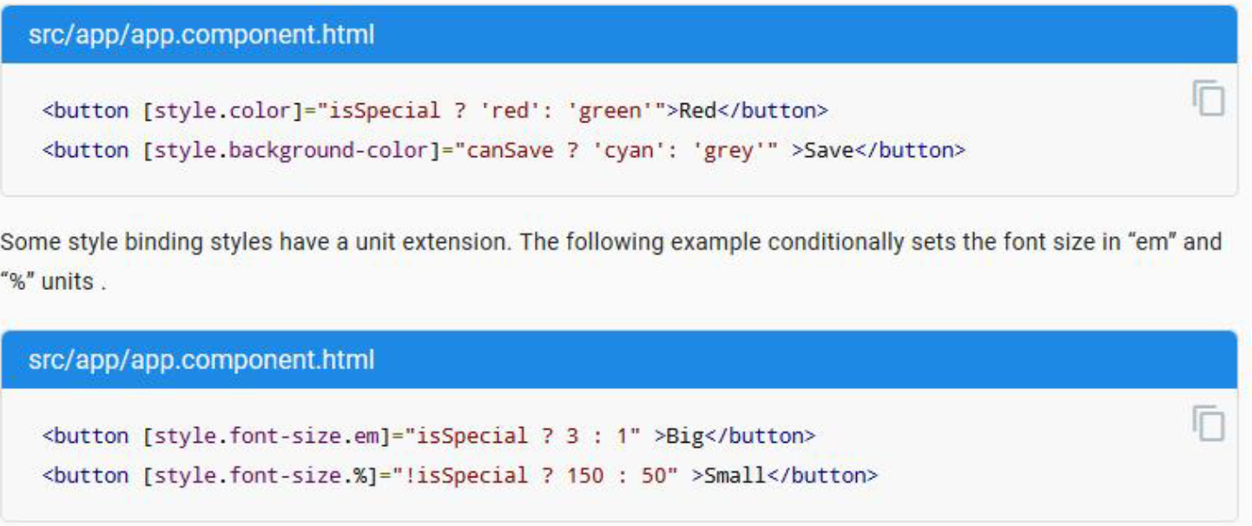
Data Binding
Class Binding
Style Binding

Slide 19
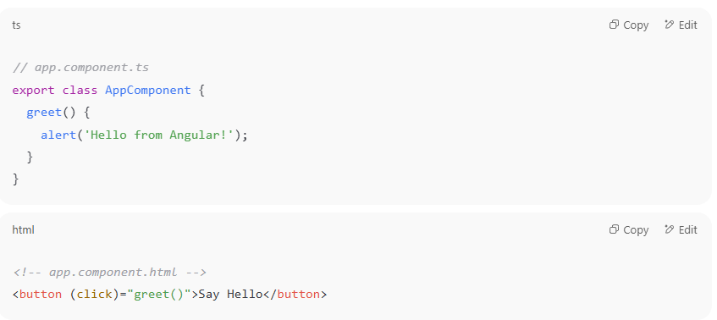
Data Binding
Event Binding

Slide 20
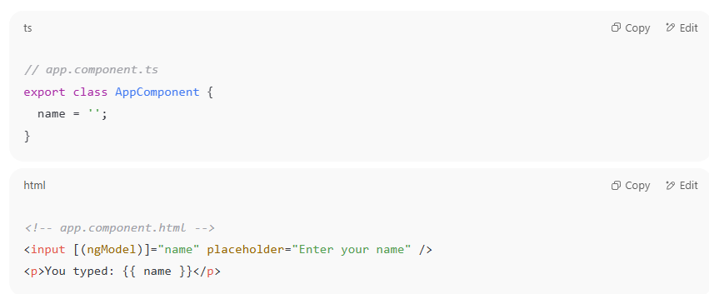
Data Binding
Two way Data Binding ( FormsModule Should be imported )

Slide 21
Directives

Slide 22
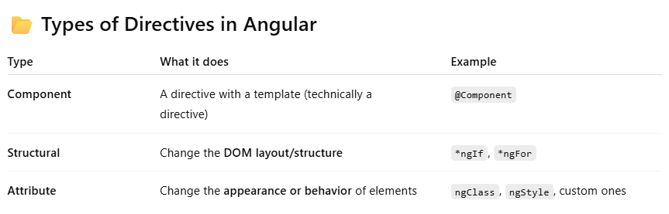
Directives
A directive is a class that lets you add behavior or manipulate the DOM in Angular templates.
Think of it as a way to teach HTML new tricks — like showing/hiding elements, repeating elements, changing styles, etc.

Slide 23
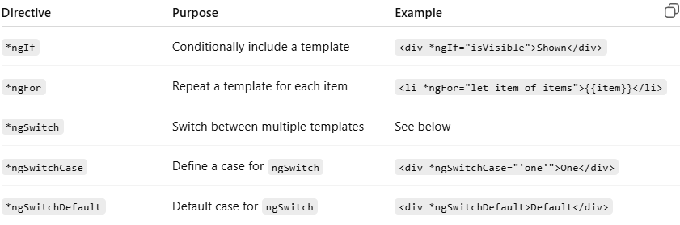
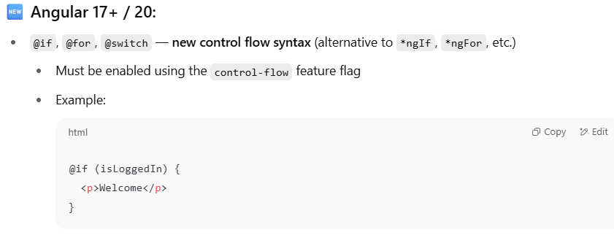
1. Structural Directives
These change the DOM layout by adding or removing elements.
Control Flow Syntax

Slide 24
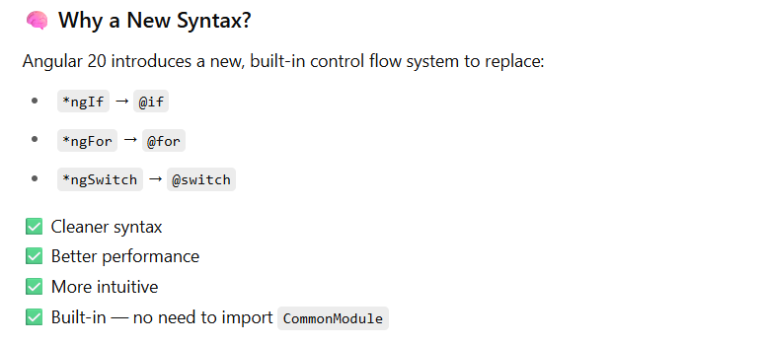
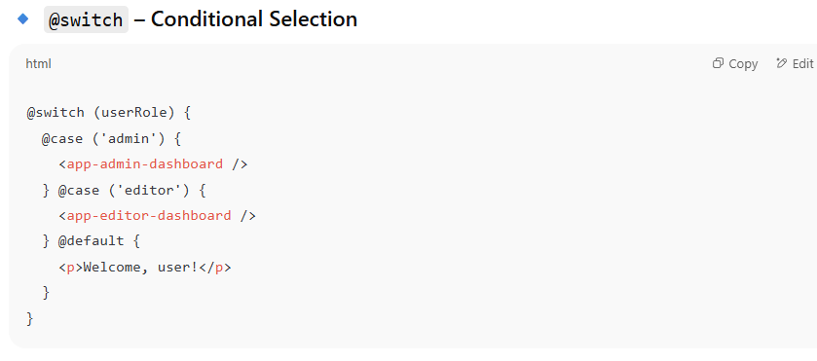
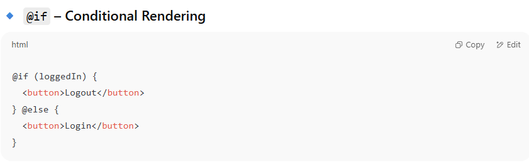
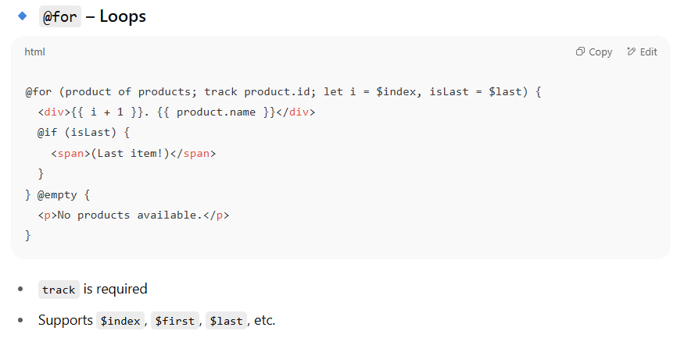

Slide 25
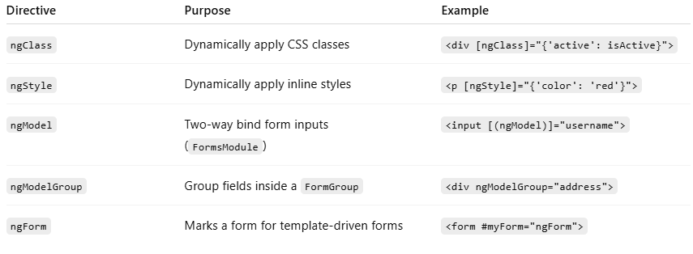
2. Attribute Directives
These change the appearance or behavior of elements.
They gonna be deprecated, the better to use ( Style, Class Binding )
[class.] = “exp”
[style.] = “exp”

Slide 26
2. Attribute Directives
ngStyle
Direct Value
Expression

Slide 27
2. Attribute Directives
ngClass
Direct Value
Expression

Slide 28
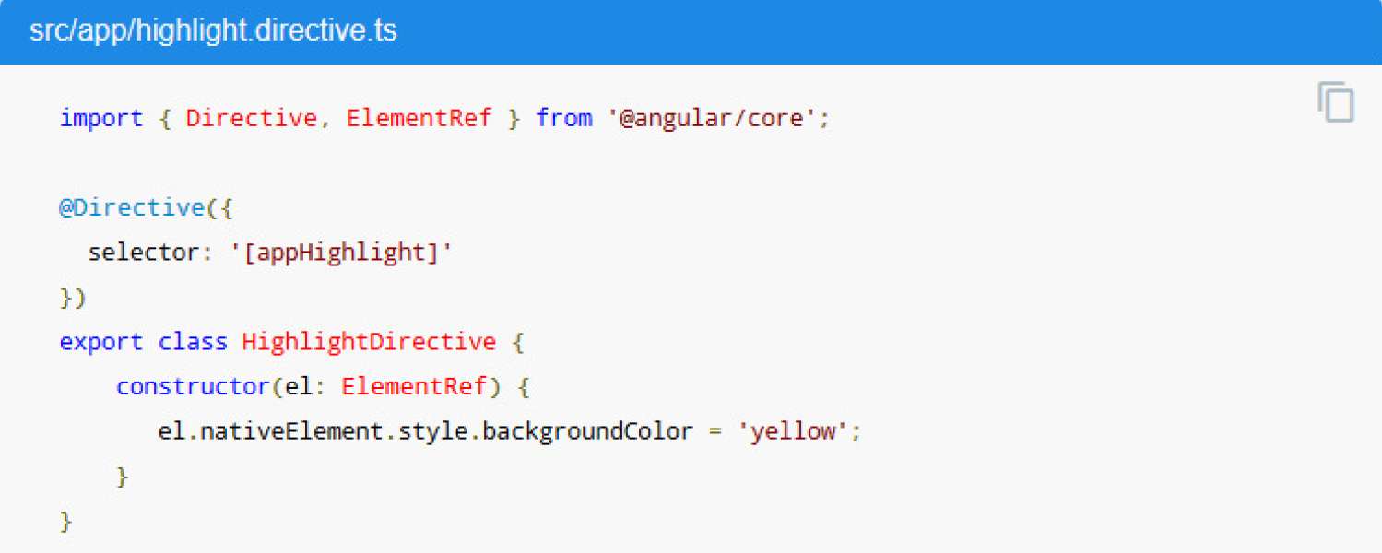
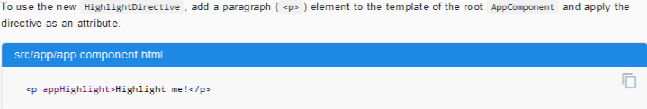
2. Attribute Directives
CUSTOM DIRECTIVE
You can create custom attribute directive and custom Structural directive

Slide 29
Pipes

Slide 30
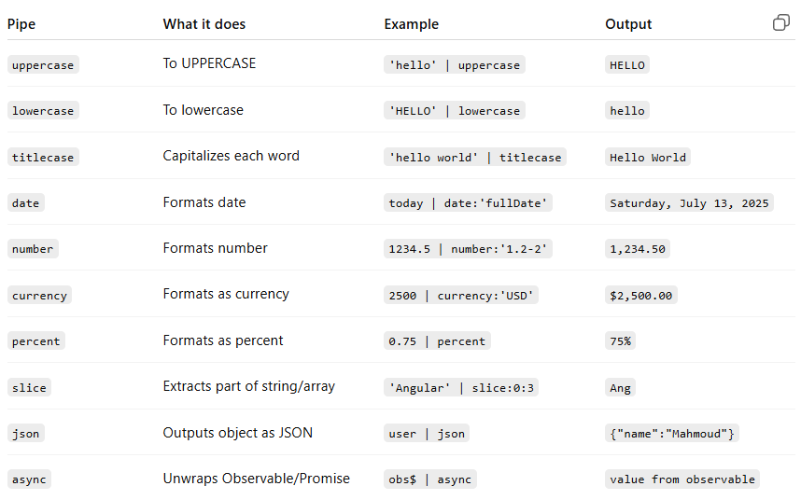
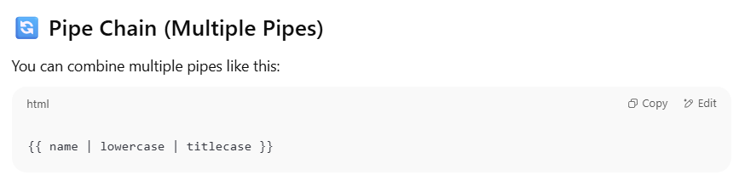
Pipes
A pipe is a function you use in the template (HTML) to transform data before displaying it. Without affecting the original Data.

Slide 31
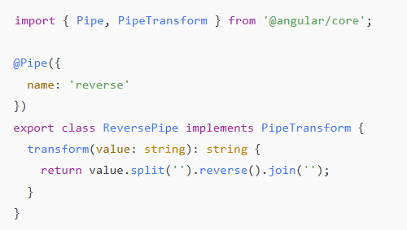
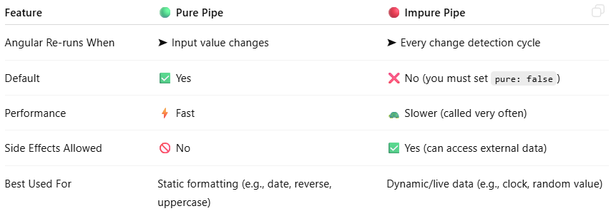
Custom Pipes
Make a custom pipe to add your own transformation logic
Ng g p <pipeName>
@Pipe: Decorator to declare the pipe
transform(): The logic that changes the data
Value:The logic that changes the data
Pure/Impure Pipes

